Slide 1

Building Logic Circuits

Slide 2
Why Do We need to build Logic Circuits?

Slide 3
Problem: How To Build an Adder?
We have seen the main binary operators.
NOT
OR
AND
etc.
How do we use these to build a logic circuit that adds binary numbers?
A | B | Carry In | Sum | Carry Out
0 | 0 | 0 | 0 | 0
0 | 0 | 1 | 1 | 0
0 | 1 | 0 | 1 | 0
0 | 1 | 1 | 0 | 1
1 | 0 | 0 | 1 | 0
1 | 0 | 1 | 0 | 1
1 | 1 | 0 | 0 | 1
1 | 1 | 1 | 1 | 1

Slide 4
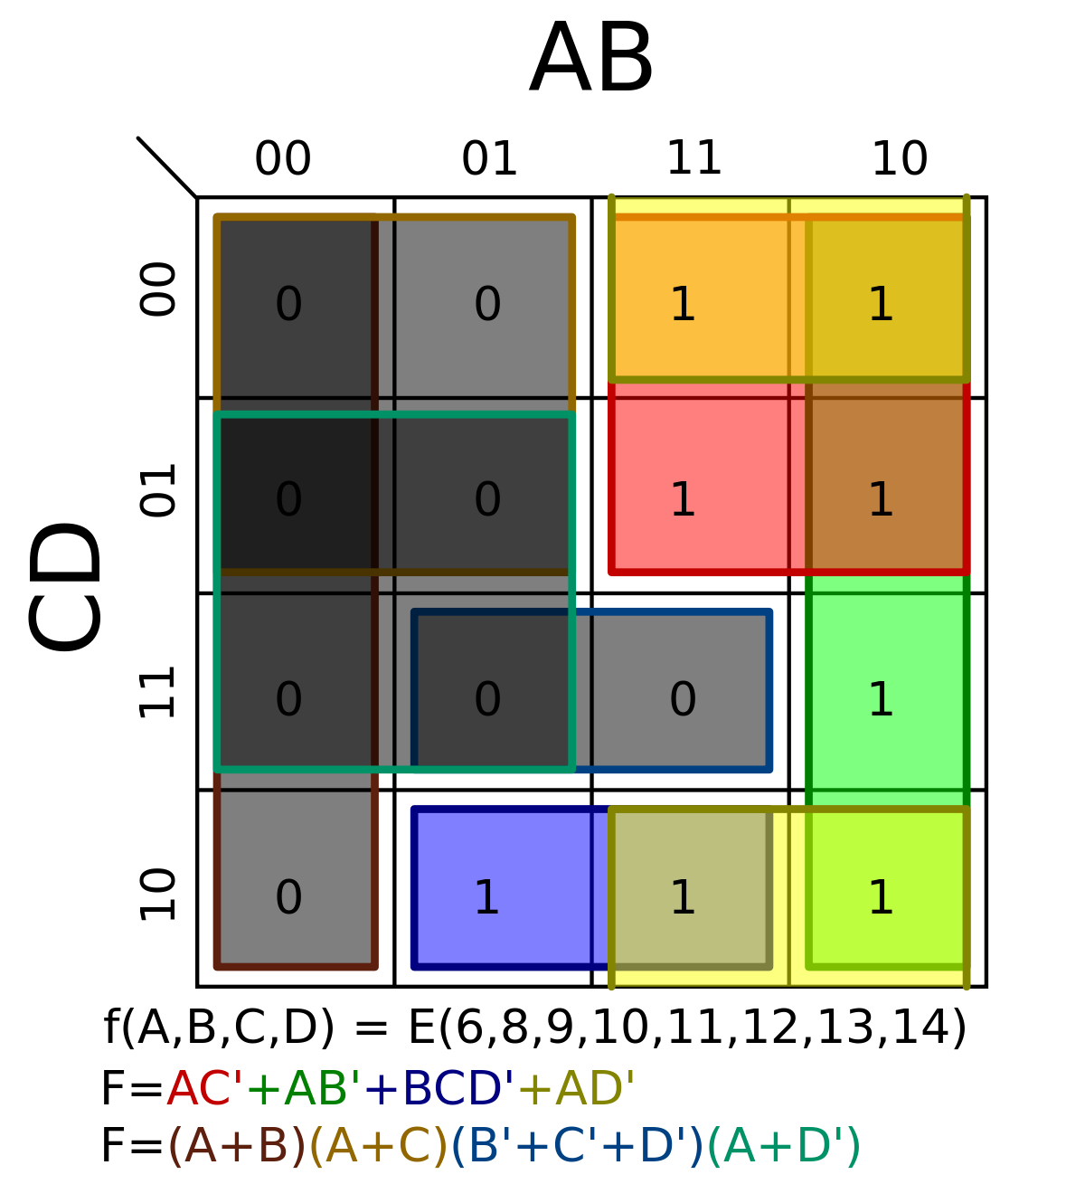
Karnaugh Map (K-map)
Simplifying Boolean expressions using laws becomes difficult and error-prone with multiple variables.
Karnaugh Maps allow us to simplify expressions visually.
It is best used for problems with 3 or 4 variables.

Slide 5

Deriving A function from a K-map
$$A$$ | $$B$$ | $$C$$ | $$f$$
0 | 0 | 0 | 0
0 | 0 | 1 | 0
0 | 1 | 0 | 1
0 | 1 | 1 | 0
1 | 0 | 0 | 1
1 | 0 | 1 | 1
1 | 1 | 0 | 1
1 | 1 | 1 | 0
AB
 | 00 | 01 | 11 | 10
0 | 0 | 1 | 1 | 1
1 | 0 | 0 | 0 | 1
C

Slide 6


Deriving A function from a K-map
$$A$$ | $$B$$ | $$C$$ | $$f$$
0 | 0 | 0 | 0
0 | 0 | 1 | 0
0 | 1 | 0 | 1
0 | 1 | 1 | 0
1 | 0 | 0 | 1
1 | 0 | 1 | 1
1 | 1 | 0 | 1
1 | 1 | 1 | 0
AB
 | 00 | 01 | 11 | 10
0 | 0 | 1 | 1 | 1
1 | 0 | 0 | 0 | 1
C
$$f=(B∧¬C)∨(A∧¬B)$$
$$f=\left(B∧¬C\right)∨\left(A∧¬B\right) \\ =\left(0∧¬1\right)∨\left(1∧¬0\right) \\ =\left(0∧0\right)∨\left(1∧1\right) \\ =0∨1=1$$
Notes:
In deriving the equation from the truth table. The values are tabulated as shown in the slide. From the truth table, the value of AB was column while the value of C was for the row. When AB = 0, and C=0, the value of the function is 0. When AB =0 and C = 1, the value of function is 1. When AB = 11 and C = 0, the value of the function was 1. This was replicated for the entire table.
To derive the function from the K-Map, we will group two continuous cells with value 1 as demonstrated in the table.
Note: This grouping can only be done for 1, 2, 4 or 8 cells because they are multiple of 2s.
In this row, C= 0 which means that the inverse is what will be useful. For the two cells, B only has constant value among the two cells. Hence, it is valid. The value of A is changing thereby making the value of 1 not dependent on it. The first operand $B\overline{C}$ was derived.
In the second group, C does not have constant value thereby making it irrelevant to the result of the function. Since AB have constant value, it will be the second operand. However, B has a value of 0 which implies that only the inverse will be used. The $A\overline{B}$ was derived.
The equation was tested and the result showed the correctness.

Slide 7


Deriving A function from a K-map
$$A$$ | $$B$$ | $$C$$ | $$f$$
0 | 0 | 0 | 0
0 | 0 | 1 | 1
0 | 1 | 0 | 0
0 | 1 | 1 | 1
1 | 0 | 0 | 1
1 | 0 | 1 | 1
1 | 1 | 0 | 1
1 | 1 | 1 | 0
A
 | 0 | 1
00 | 0 | 1
01 | 1 | 1
11 | 1 | 0
10 | 0 | 1
BC
$$f=(¬A∧C)∨(A∧¬B)∨(A∧B∧¬C)$$

Slide 8
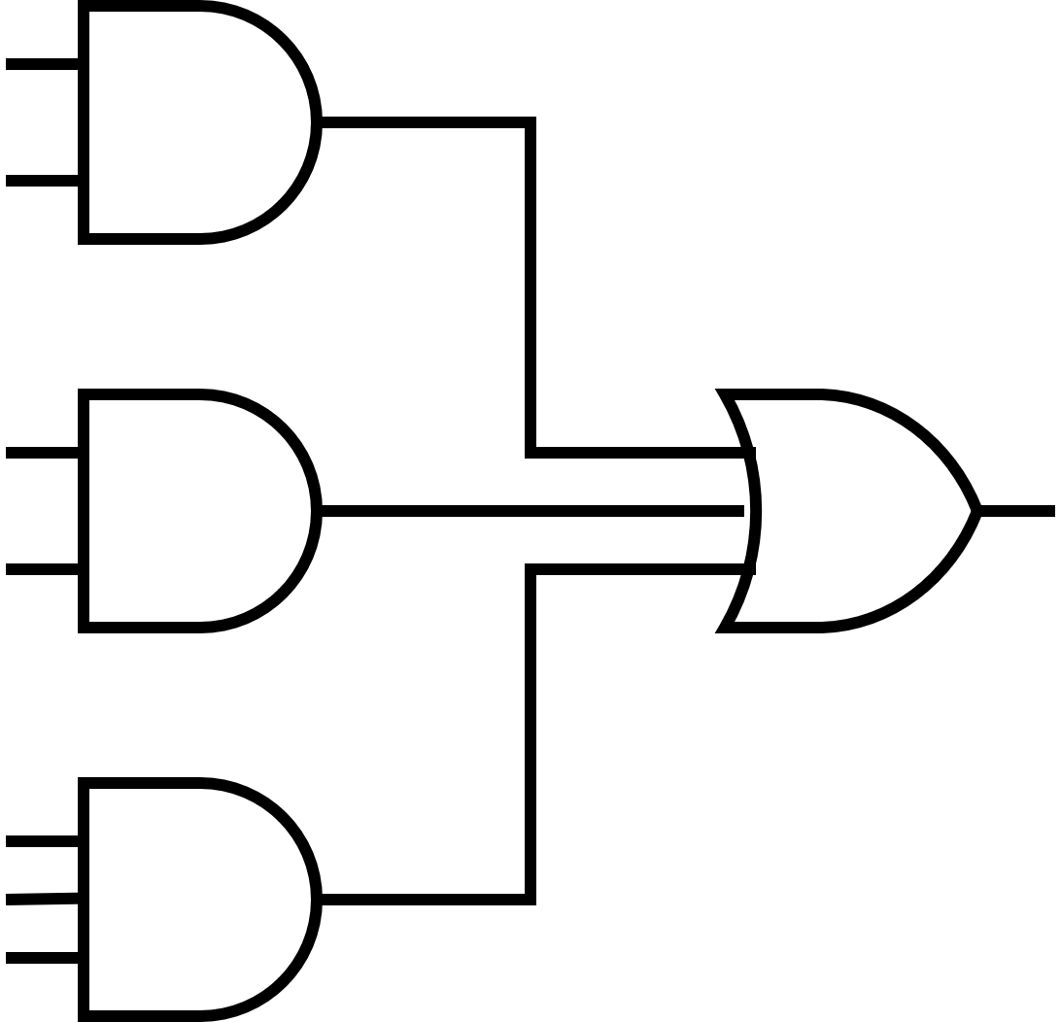
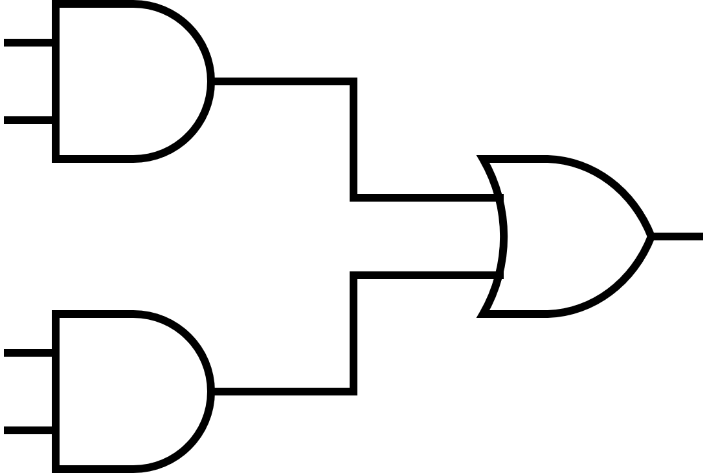




















Turning the Function into a Circuit Diagram
$$f=(B∧¬C)∨(A∧¬B)$$
$$f=(¬A∧C)∨(A∧¬B)∨(A∧B∧¬C)$$
$$¬A$$
$$¬A∧C$$
$$B$$
$$C$$
$$B∧¬C$$
$$¬C$$
$$f$$
$$A$$
$$f$$
$$A∧¬B$$
$$¬B$$
$$A$$
$$A∧¬B$$
$$¬B$$
$$A$$
$$B$$
$$A∧B∧¬C$$
$$¬C$$

Slide 9
Karnaugh maps (K-map) allow us to build and simplify binary functions.
A K-map provides a function using only and and or gates.
We can simply translate the binary function into a circuit diagram.
Original Slides By Pelumi Apantaku.
Updated Slides by Kevin Chalmers.
Video By Kevin Chalmers.
Images courtesy of Wikimedia.

